Slide 1
Semantic Phase of the Compiler

Slide 2
Functions of the semantic phase
Converting the parse tree to an annotated parse tree
Syntax directed Definition (SDD)
Sequence of semantic rules
Syntax directed Translation (SDT)
Uses SDD to convert one representation to another
Writing semantic rules to check for semantic correctness
Establishing evaluation order

Slide 3
The Structure of our Compiler
Character stream
Lexical analyzer
Syntax-directed translator
Token stream
Java bytecode
Lex specification
Yacc specification with semantic rules
JVM specification

Slide 4
Syntax-Directed Definitions
SDD uses a CFG to specify the syntactic structure of the input
SDD connects a set of semantic rules to productions
Terminals and non-terminals have attributes
A depth-first traversal algorithm is used to compute the values of the attributes in the parse tree using the semantic rules
After the traversal is completed, the attributes contain the translated form of the input

Slide 5
Example Attribute Grammar
Production
Semantic Rule
L → E n E → E₁ + T E → T T → T₁ * F T → F F → ( E )
F → digit
print(E.val) E.val := E₁.val + T.val E.val := T.val T.val := T₁.val * F.val T.val := F.val F.val := E.val F.val := digit.lexval

Slide 6
Attributes
Attribute values can represent
Numbers (literal constants)
Strings (literal constants)
Memory locations, such as a frame index of a local variable or function argument
A data type for type checking of expressions
Scoping information for local declarations
Intermediate program representations

Slide 7
Synthesized Vs Inherited Attributes
Given a production A → α then each semantic rule is of the form b := f(c₁,c₂,…,c_{k}) where f is a function and c_{i} are attributes of A and α, and either
b is a synthesized attribute of A and c₁,c₂,…,c_{k} are attributes belonging to the grammar symbols of the production or
b is an inherited attribute of one of the grammar symbols in α, and c₁,c₂,…,c_{k} are attributes belonging to the grammar symbols of the production

Slide 8
Synthesized vs Inherited Attribute
Synthesized
For a node N, for a non-terminal A, attributes are defined by value of the children; and the node itself – terminals
Inherited
For a node N, the value is computed from the values of attributes at the siblings and parent of that node

Slide 9
Synthesized Vs Inherited Attributes
Production
Semantic Rule
inherited
D → T L T → int … L → id
L.in := T.type T.type := ‘integer’ … … := L.in
synthesized

Slide 10
Synthesized+Inherited Attributes
Production
Semantic Rule
D → T L T → int T → real L → L₁ , id L → id
L.in := T.type T.type := ‘integer’ T.type := ‘real’ L₁.in := L.in; addtype(id.entry, L.in) addtype(id.entry, L.in)

Slide 11
Annotated Parse Tree
D → T L T → int T → real L → L₁ , id L → id
D
T.type = ‘real’
L.in = ‘real’
real
L.in = ‘real’
,
id₃.entry
L.in = ‘real’
,
id₂.entry
id₁.entry
Sentence: real id₁, id₂, id₃

Slide 12
Grammar with Synthesized + Inherited Attributes
Production
Semantic Rule
D → T L T → int T → real L → L₁ , id L → id
L.in := T.type T.type := ‘integer’ T.type := ‘real’ L₁.in := L.in; addtype(id.entry, L.in) addtype(id.entry, L.in)
Synthesized: T.type, id.entry Inherited: L.in

Slide 13
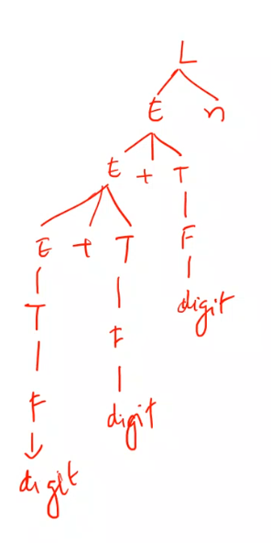
Annotated Parse Tree
Parse tree showing the attribute values at each node
L
E.val = 16
E.val = 14
T.val = 2
E.val = 9
T.val = 5
F.val = 2
T.val = 9
F.val = 5
F.val = 9
9
+
5
+
2
n
Notes:
The process of computing the attribute values at the node is called annotating.

Slide 14
Annotating a Parse Tree
procedure visit(n : node); begin for each child m of n, from left do visit(m); evaluate semantic rules at node n end
Notes:
Postorder traversal

Slide 15
S-Attributed Definitions
A syntax-directed definition that uses synthesized attributes exclusively is called an S-attributed definition (or S-attributed grammar)
A parse tree of an S-attributed definition can be annotated with a simple bottom-up traversal (LR parser)
Yacc supports S-attributed definitions

Slide 16
L-Attributed Definitions
A syntax-directed definition is L-attributed if each inherited attribute of X_{j} on the right side of A → X₁ X₂ … X_{n} depends only on
the attributes of the symbols X₁, X₂, …, X_{j-1}
the inherited attributes of A or
Attribute can be Synthesized

Slide 17
L-Attributed Definitions
L-attributed definitions does a normal order of evaluating attributes which is depth-first and left to right
Every S-attributed syntax-directed definition is also L-attributed
A → X Y
A
X.i := A.i Y.i := X.s A.s := Y.s
X.i:=A.i
A.s:=Y.s
X
Y
Y.i:=X.s

Slide 18
Dependency graph
The interdependencies among the inherited and synthesized attributes at the nodes in a parse tree can be depicted by a directed graph called dependency graph
Node for each attribute; and an edge to the node for b from the node for c if attribute b depends on attribute c

Slide 19
Dependence Graph
A.a
A → X Y
A.a := f(X.x, Y.y)
X.x
Y.y
A.a
X.x := f(A.a, Y.y)
X.x
Y.y
A.a
Direction of value dependence
Y.y := f(A.a, X.x)
X.x
Y.y

Slide 20
Dependency Graphs with Cycles?
Edges in the dependence graph show the evaluation order for attribute values
Dependency graphs cannot be cyclic
A.a
A.a := f(X.x) X.x := f(Y.y) Y.y := f(A.a)
X.x
Y.y
Error: cyclic dependence

Slide 21
Evaluation Order
A topological sort of a directed acyclic graph (DAG) is any ordering m₁, m₂, …, m_{n} of the nodes of the graph, such that if m_{i}→m_{j} is an edge then m_{i} appears before m_{j}
Any topological sort of a dependency graph gives a valid evaluation order for the semantic rules

Slide 22
Example Topological sorting
D
T₁.type = ‘real’
4
5
L₁.in = ‘real’
6
real
7
L₂.in = ‘real’
8
,
3
id₃.entry
9
L₃.in = ‘real’
10
,
2
id₂.entry
1
id₁.entry

Slide 23
Example Topological sorting
1. Get id₁.entry 2. Get id₂.entry 3. Get id₃.entry
4. T₁.type=‘real’ 5. L₁.in=T₁.type 6. addtype(id₃.entry, L₁.in) 7. L₂.in=L₁.in 8. addtype(id₂.entry, L₂.in) 9. L₃.in=L₂.in 10. addtype(id₁.entry, L₃.in)
D
T₁.type = ‘real’
4
5
L₁.in = ‘real’
6
real
7
L₂.in = ‘real’
8
,
3
id₃.entry
9
L₃.in = ‘real’
10
,
2
id₂.entry
1
id₁.entry

Slide 24
Syntax Directed Translation
A parse tree is called a concrete syntax tree
An abstract syntax tree (AST) is defined by the compiler writer as a more convenient intermediate representation
It is a condensed form of the parse tree useful for representing language constructs

Slide 25
Construction of Syntax Trees
The nodes of a syntax tree can be objects or records with a suitable number of fields.
Each object will have an op field that is the label of the node. The objects will have additional fields as follows:
If the node is a leaf, an additional field holds the lexical value for the leaf. A constructor function Leaf (op, val) creates a leaf object. Alternatively, if nodes are viewed as records, then Leaf returns a pointer to a new record for a leaf.
If the node is an interior node, there are as many additional fields as the node has children in the syntax tree. A constructor function Node takes two or more arguments: Node(op, c₁, c₂, … , c_{k}) creates an object with first field op and k additional fields for the k children c₁, c₂, … , c_{k}.

Slide 26
Generating syntax tree
Production
E → E₁ + T E → E₁ - T E → T T → T₁ * id T → T₁ / id T → id
T → num
Semantic Rule E.nptr := mknode(‘+’, E₁.nptr, T.nptr)
E.nptr := mknode(‘-’, E₁.nptr, T.nptr)
E.nptr := T.nptr
T.nptr := mknode(‘*’, T₁.nptr, mkleaf(id, id.entry))
T.nptr := mknode(‘/’, T₁.nptr, mkleaf(id, id.entry))
T.nptr := mkleaf(id, id.entry)
T.nptr := mkleaf(num, num.val)

Slide 27
Generating Abstract Syntax Trees
Synthesize AST
E.nptr
E.nptr
+
T.nptr
T.nptr
T.nptr
*
id
id
id
+
id
*
id
id

Slide 28
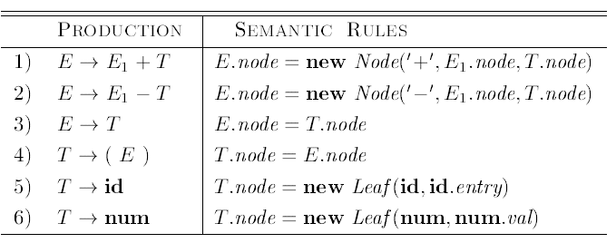
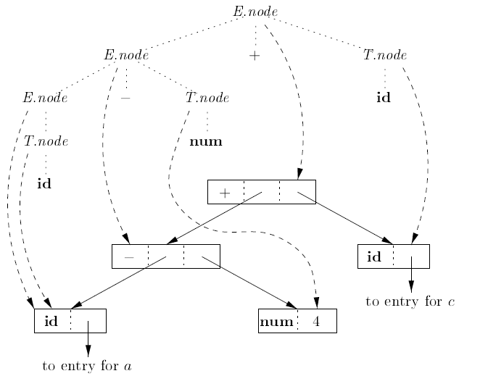
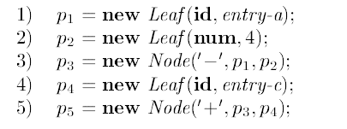

Slide 29
Translation Scheme
D → T { L.in := T.type } L T → int { T.type := ‘integer’ } T → real { T.type := ‘real’ } L → { L₁.in := L.in } L₁ , id { addtype(id.entry, L.in) } L → id { addtype(id.entry, L.in) }

Slide 30
Directed Acyclic Graphs for Expressions
DAG has leaves corresponding to atomic operands and interior nodes corresponding to operators
The difference is that a node N in a DAG has more than one parent if N represents a common subexpression; in a syntax tree, the tree for the common subexpression would be replicated as many times as the subexpression appears in the original expression
Thus, a DAG not only represents expressions more succinctly, it gives the compiler important clues regarding the generation of efficient code to evaluate the expressions.

Slide 31

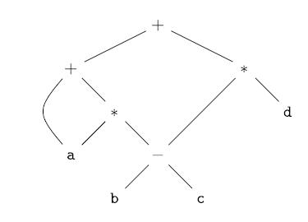

Slide 32
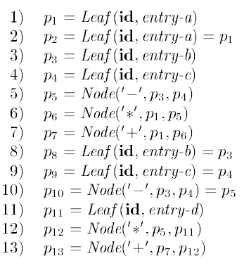

Slide 33
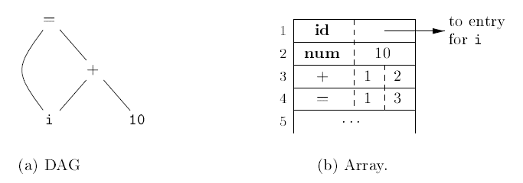
Value-Number Method for Constructing DAG's

Slide 34
Let the signature of an interior node be the triple <op, l, r>, where op is the label, l its left child's value number, and r its right child's value number.
A unary operator may be assumed to have r = 0.
Algorithm: Value-number method for constructing the nodes of a DAG
INPUT: Label op, node l, and node r.
OUTPUT: The value number of a node in the array with signature <op, l, r>,.
METHOD: Search the array for a node M with label op, left child l, and right child r. If there is such a node, return the value number of M. If not, create in the array a new node N with label op, left child l, and right child r, and return its value number.

Slide 35
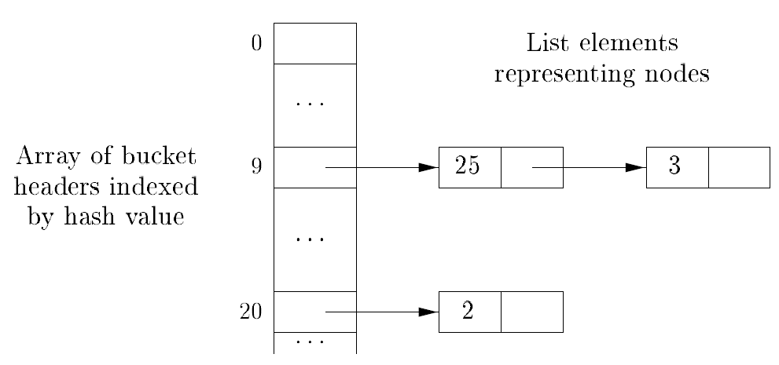
Data structure for searching buckets
The buckets can be implemented as linked lists. An array, indexed by hash value, holds the bucket headers, each of which points to the first cell of a list. Within the linked list for a bucket, each cell holds the value number of one of the nodes that hash to that bucket. That is, node <op, l, r> can be found on the list whose header is at index h(op, l, r) of the array

Slide 36
Type Checking
Need to verify that the source program follows the syntactic and semantic conventions – Static checking
Helps in reporting programming errors

Slide 37
Static Checking
Type Checking – operator applied to an incompatible operand
Example: error if array variable is added with function variable
Flow of control check – statements that results in a branch need to be terminated correctly
Example: Break statements

Slide 38
Static Checking
Uniqueness check – object must be defined exactly once for some scenarios
Example: labels in case statements need to be unique in pascal, identifiers need to be unique
Name-related checks – Same name appears more than once
Example: Ada where a name appears more than once (beginning and end of block/loop) and compiler to verify this

Slide 39
Type Checking
int op(int);
int f(float);
int a, c[10], d;
d = c+d; // FAIL
*d = a; // FAIL
a = op(d); // OK: overloading (C++)
a = f(d); // OK: coersion
vector<int> v;//OK: template instantiation

Slide 40
Flow of control check
myfunc() { …
while (n)
{ …
if (i>10)
break; // OK
}
}
myfunc() { …
break; // ERROR
}

Slide 41
Uniqueness check
myfunc() { int i, j, i; // ERROR …
}
cnufym(int a, int a) // ERROR
{ …
}

Slide 42
Position of Type checker
Syntax Tree
Syntax Tree
Tokens
Parser
Type checker
Intermediate code generator

Slide 43
Type Checking
Is carried out in semantic phase
Type checking information added with the semantic rules
Basic type checking is performed
This is extended to type checking of complex attributes

Slide 44
Type Checking of Expressions
E → literal {E.type = char}
E → num {E.type = integer}
E → id {E.type = lookup(id.entry}
E → E1 mod E2 { E.type =
{if E1.type == integer and E2.type == integer then integer
else type_error}

Slide 45
Type Checking of Expressions
E → E1[E2] {E.type =
if E2.type == integer and E1.type == array(s,t) then t
else type_error}
E → E1↑ {E.type = if E1.type == ptr(t)
then t
else type_error}

Slide 46
Type Checking of statements
P → D; S
D → D; D
D → id: T { addtype(id.entry, T.type) }
T → char { T.type = char }
T → int { T.type = integer }
T → ↑T₁ { T.type = pointer(T₁.type) }
S → id := E {S.type =
if id.type == E.type then void
else type_error}

Slide 47
Type Checking of statements
S → if E then S1 {S.type =
if E.type == boolean
then S1.type
else type_error}
S → while E do S1 { S.type =
if E.type == boolean
then S1.type
else type_error}
S → S1 ; S2 {S.type =
if S1.type == void and S2.type == void
then void else type_error }

Slide 48
Type checking of functions
E → E1 (E2) {E.type =
if E2.type == s and E1.type = s→ t
then t else type_error}
T → T1 ‘→’ T2 { T.type = T1.type → T2.type}

Slide 49
Type checking rules for coercions
Coercion – Implicit type conversions done by the compiler
Explicit type conversion – done by the programmer

Slide 50
Type checking for coercions
E → num E.type = integer
E → num.num E.type = real
E → id E.type = lookup (id.entry)

Slide 51
Type checking for coercions
E → E1 op E2 E.type =
if E1.type == integer and E2.type == integer
then integer
else if E1.type == integer and E2.type == real then real
else if E1.type == real and E2.type == integer then real
else if E1.type == real and E2.type == real
then real
else type_error

Slide 52
Summary
Attributes type has been discussed
Construction of Dependency graph
Topological sorting for evaluation order
Type checking

